Slide 1
Unit-II Client-side Technologies: JavaScript & DOM

Slide 2
Outline
JavaScript: Overview of JavaScript, using JS in an HTML (Embedded, External), Data types, Control Structures, Arrays, Functions and Scopes, Objects in JS, JavaScript debugger
DOM: DOM levels, DOM Objects and their properties and methods, Manipulating DOM,
JQuery: Introduction to JQuery, Loading JQuery, Selecting elements, changing styles, creating elements, appending elements, removing elements, handling events.

Slide 3
Introduction to JavaScript
JavaScript is one of the 3 languages all web developers have to learn:
1. HTML to define the content of web pages
2. CSS to specify the layout of web pages
3. JavaScript to program the behavior of web pages
JavaScript is a powerful client-side scripting language used in web pages to dynamically add functionality, validate or auto-correct form data, communicating with server (with AJAX) and read-write HTML elements (enable/disable a button)

Slide 4
JavaScript
JavaScript is a front-end scripting language developed by Brendan Eich at Netscape for dynamic content
Lightweight, but with limited capabilities
Can be used as object-oriented language
Client-side technology:
Embedded in your HTML page or create an External .js file
Web browser are equipped with JavaScript interpreter
Simple, un-typed and high-level language
Powerful to manipulate the DocumentObjectModel
Every browser use some DOM to make web pages accessible via JS
6

Slide 5
JavaScript Advantages
JavaScript allows interactivity such as:
Implementing form validation
React to user actions, e.g. highlight paragraphs
Changing an image on moving mouse over it
Sections of a page appearing and disappearing
Content loading and changing dynamically
Performing complex calculations
Custom HTML controls, e.g. scrollable table
Implementing AJAX functionality
7

Slide 6
What Can JavaScript Do?
Can handle events
Can read and write HTML elements
Can validate form data
Can access / modify browser cookies
Can detect the user’s browser and OS
Can be used as object-oriented language
Can handle exceptions
Can perform asynchronous server calls (AJAX)
8

Slide 7
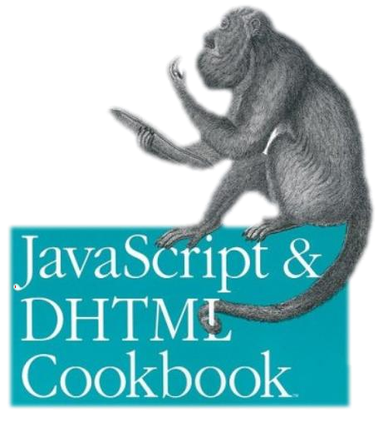

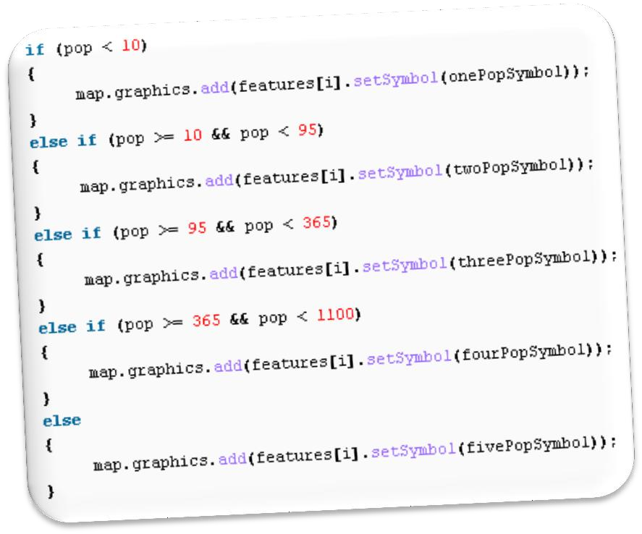



The JavaScript
Syntax

Slide 8
JavaScript Syntax
JavaScript can be implemented using <script>... </script> HTML tags in a web page.
Place the <script> tags, within the <head> tags.
Syntax:
<script type="text/javascript">
// JavaScript code
</script>

Slide 9
JavaScript Syntax
Example:
<html>
<body>
<script type="text/javascript">
// document.write("Hello World!")
document.write(“Introducing JavaScript..")
</script>
</body>
</html>
Output
Hello World!
Comments are made in JavaScript by adding // before a single line, or /* before and */ after multiple lines.

Slide 10
JavaScript Syntax
The JavaScript syntax is similar to C# and Java
Operators (+, *, =, !=, &&, ++, …)
Variables (typeless)
Conditional statements (if, else)
Loops (for, while)
Arrays (my_array[]) and associative arrays (my_array['abc'])
Functions (can return value)
12

Slide 11
JavaScript Editor and Extension
Use Notepad to write the code
Save the document using .html (if embedded JavaScript)
Save document with .js (if external JavaScript)
Run the code in browser

Slide 12
JavaScript - Placement in HTML File
There is a flexibility given to include JavaScript code anywhere
in an HTML document.
However the most preferred ways to include JavaScript in an HTML file are as follows −
Script in <head>...</head> section.
Script in <body>...</body> section.
Script in <body>...</body> and <head>...</head> sections.
Script in an external file is usually included in
<head>...</head> section.

Slide 13
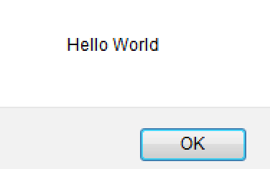
JavaScript in <head>...</head> section
<html>
<head>
<script type="text/javascript">
function sayHello( )
{
alert("Hello World")
}
</script>
</head>
<body>
<input type="button" value="Say Hello" onclick="sayHello( )" />
</body>
</html>

Slide 14
JavaScript in <body>...</body> section
<html>
<head> </head>
<body>
<script type="text/javascript">
document.write("Hello World")
</script>
<p>This is web page body </p>
</body>
</html>
This code will produce the following results −
Hello World
This is web page body

Slide 15
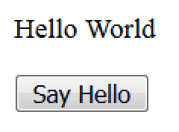
JavaScript in <body> and <head>
<html>
<head>
<script type="text/javascript">
function sayHello()
{ alert("Hello World") }
</script>
</head>
<body>
<script type="text/javascript">
document.write("Hello World")
</script>
<input type="button" value="Say Hello" onclick="sayHello()" />
</body> </html>
This code will produce the following result −

Slide 16
JavaScript in External File
HTML File
<html>
<head>
<script type="text/javascript" src="filename.js" >
</script>
</head>
<body> ....... </body>
</html>
JavaScript File – filename.js
function sayHello()
{ alert("Hello World") }

Slide 17
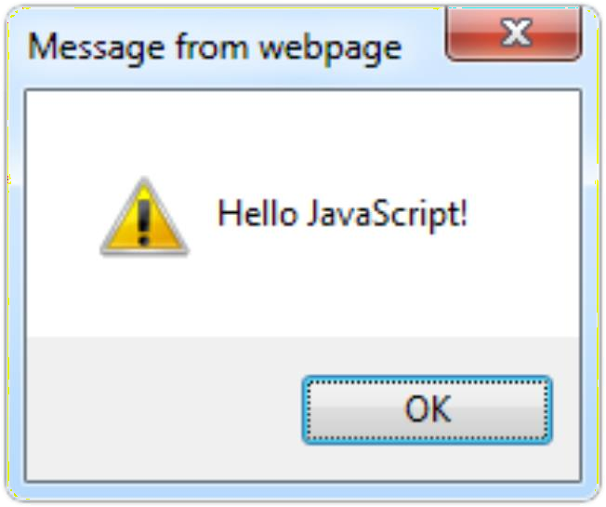

The First Script
first-script.html
<html>
<body>
<script type="text/javascript"> alert('Hello JavaScript!');
</script>
</body>
</html>
20

Slide 18
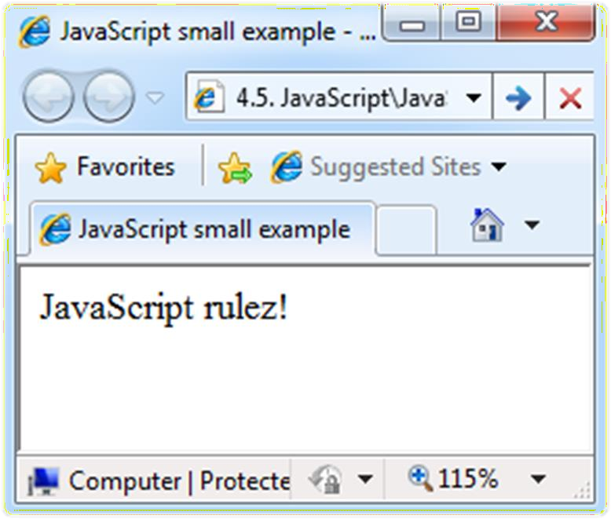

Another Small Example
small-example.html
<html>
<body>
<script type="text/javascript"> document.write('JavaScript rulez!');
</script>
</body>
</html>
21

Slide 19
Using JavaScript Code
External files are linked via <script> tag in the <head> tag
Files have .js extension
The .js files get cached by the browser
Do not use internal scripting along with external files in same <script> tag
<script src="scripts.js" type="text/javscript">
//code placed here will not be executed!
</script>
22

Slide 20
JavaScript – When is Executed?
JavaScript code is executed during the page loading or when the browser fires an event
All statements are executed at the time of page loading
Some statements just define functions that can be called later
Function calls or code can be attached as "event handlers" via different tag attributes
Executed when the event is fired by the browser
23
<img src="logo.gif" onclick="alert('clicked!')" />

Slide 21
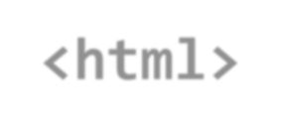
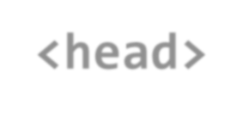
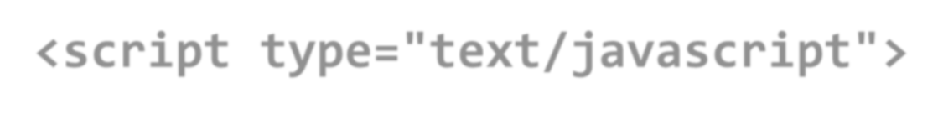

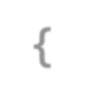
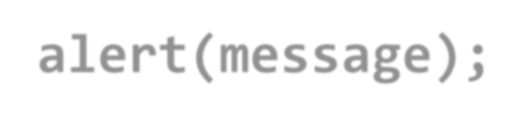
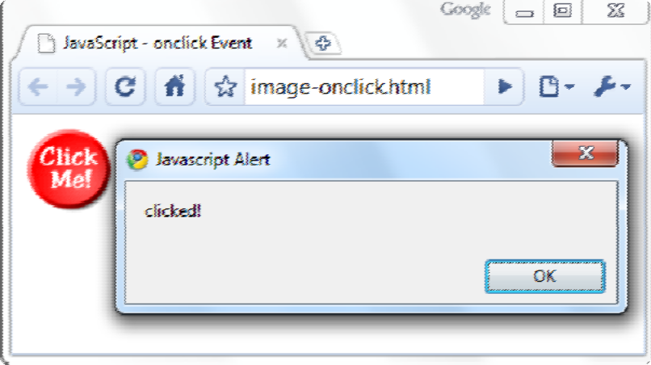
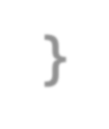
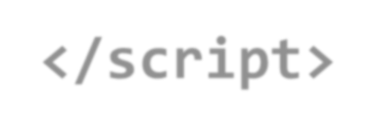
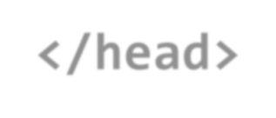
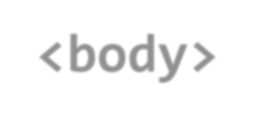
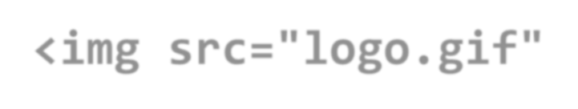

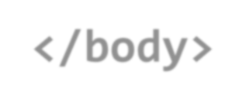
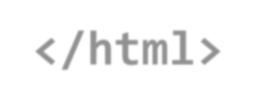
Calling a JavaScript Function from an Event Handler attribute
image-onclick.html
24

Slide 22


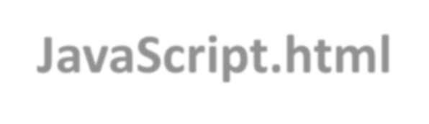

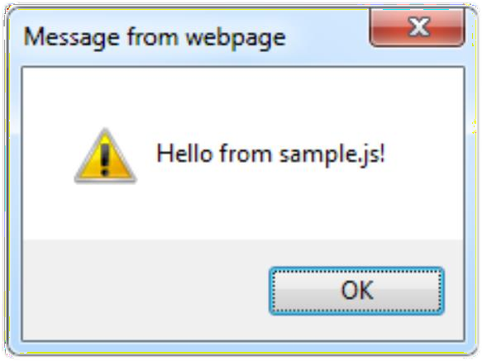

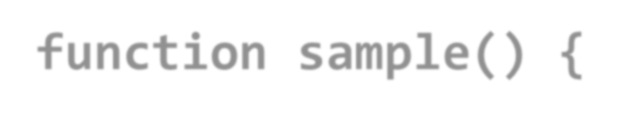
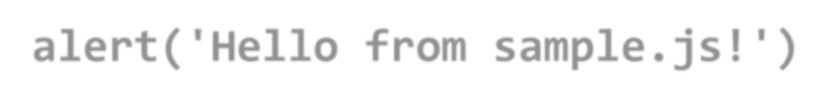
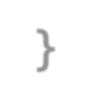
Using External Script Files
Using external script files:
<html>
<head>
<script src="sample.js" type="text/javascript">
</script>
</head>
<body>
25
<input type=“button" onclick="sample()" value="Call JavaScript function from sample.js" />
</body>
</html>
External JavaScript file:sample.js

Slide 23

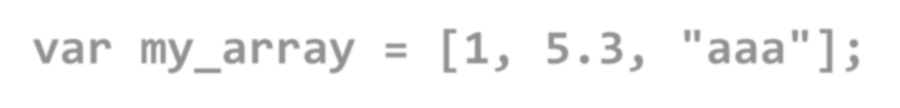
Data Types & Variables
JavaScript data types:
Numbers (integer, floating-point)
Boolean (true / false)
String type – string of characters
var myName = "You can use both single or double quotes for strings";
Arrays
26
var my_array = [1, 5.3, "aaa"];

Slide 24
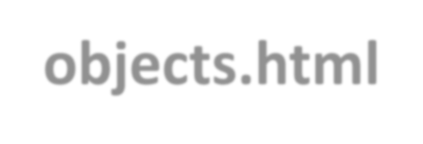
Everything is Object
In JavaScript, every variable can be considered as object
For example strings and arrays have member functions:
var test = "some string"; alert(test[7]); // shows letter 'r'
alert(test.charAt(5)); // shows letter 's' alert("test".charAt(1)); //shows letter 'e' alert("test".substring(1,3)); //shows 'es'
27
var arr = [1,3,4];
alert (arr.length); // shows 3 arr.push(7); // appends 7 to end of array alert (arr[3]); // shows 7

Slide 25
String Operations
The + operator joins strings
string1 = "fat ";
string2 = "cats";
alert(string1 + string2);
// fat cats
28
What is "9" + 9?
alert("9" + 9);
// 99
Converting string to number:
alert(parseInt("9") + 9);
// 18

Slide 26
Arrays Operations and Properties
Declaring new empty array:
var arr = new Array();
Declaring an array holding few elements:
var arr = [1, 2, 3, 4, 5];
29
Appending an element / getting the last element:
arr.push(3);
var element = arr.pop();
Reading the number of elements (array length):
arr.length;
Finding an element's index in the array:
arr.indexOf(1);

Slide 27
Standard Popup Boxes
Alert box with text and [OK] button
Just a message shown in a dialog box:
alert("Some text here");
30
Confirmation box
Contains text, [OK] button and [Cancel] button:
confirm("Are you sure?");
Prompt box
Contains text and an input field with some default value:
prompt ("enter amount", 10);

Slide 28
JavaScript Variables
<script type="text/javascript">
var name = "Anand";
var money;
money = 2000.50;
</script>
Objects are Variables
JavaScript variables can contain single values:
let person = "John Doe";
JavaScript variables can also contain many values:
let person = {firstName:"John", lastName:"Doe", age:50, eyeColor:"blue"};

Slide 29
4 Ways to Declare a JavaScript Variable:
Using var
Using let
Using const
Using nothing
When to Use JavaScript var?
Always declare JavaScript variables with var,let, or const.
The var keyword is used in all JavaScript code from 1995 to 2015. Its scope is function where it is defined.
The let and const keywords were added to JavaScript in 2015. Its scope is a block in which it is defined.
If you want your code to run in older browser, you must use var.

Slide 30
Sum of Numbers – Example
sum-of-numbers.html
<html>
<head>
<title>JavaScript Demo</title>
<script type="text/javascript">
function calcSum() { value1 =
parseInt(document.mainForm.textBox1.value); value2 =
parseInt(document.mainForm.textBox2.value); sum = value1 + value2;
alert('Sum='+sum);
}
</script>
</head>
32

Slide 31
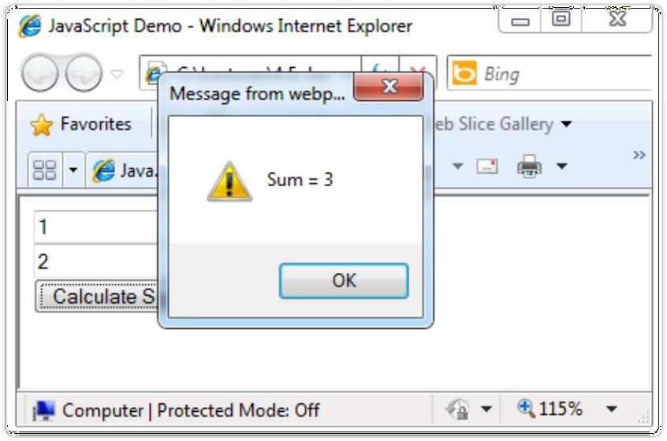

sum-of-numbers.html (cont.)
<body>
<form name="mainForm">
<input type="text" name="textBox1" /> <br/>
<input type="text" name="textBox2" /> <br/>
<input type="button" value="Calculate Sum"
onclick="javascript: calcSum()" />
</form>
</body>
</html>
33

Slide 32
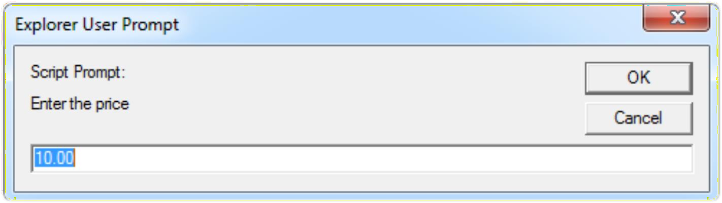

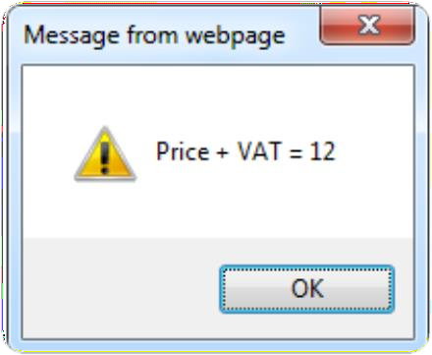

JavaScript Prompt – Example
prompt.html
price = prompt("Enter the price", "10.00"); alert('Price + VAT = ' + price * 1.2);
34

Slide 33
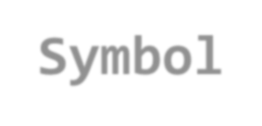

















JavaScript - Operators
Arithmetic Operators
Comparison Operators
Logical (or Relational) Operators
Assignment Operators
Conditional (or ternary) Operators

Slide 34
Conditional Statement (if)
unitPrice = 1.30;
if (quantity > 100) {
unitPrice = 1.20;
}
36

Slide 35



Switch Statement
The switch statement:
switch (variable) { case 1:
// do something break;
case 'a':
// do something else
break; case 3.14:
// another code break;
default:
switch-statements.html
37
// something completely different
}

Slide 36
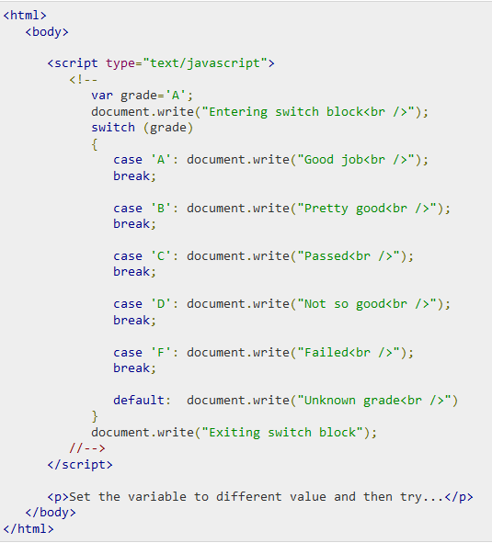
Switch case Example

Slide 37
Loops
for loop
while loop
do … while loop
39
var counter;
for (counter=0; counter<4; counter++)
{
alert(counter);
}
while (counter < 5)
{
alert(++counter);
}

Slide 38
While-loop Example
<html>
<body>
<script type="text/javascript">
<!--
var count = 0;
document.write("Starting Loop ");
while (count < 10){
document.write("Current Count : " + count + "<br />"); count++;
}
document.write("Loop stopped!");
</script>
<p>Set the variable to different value and then try...</p>
</body> </html>

Slide 39


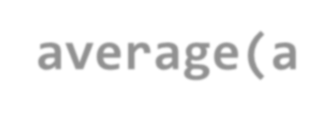
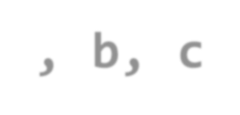




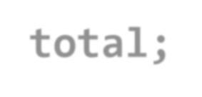


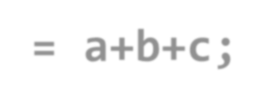


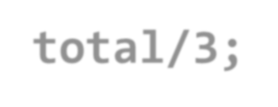




Functions: Code structure – splitting code into parts
Data comes in, processed, result returned
A JavaScript function is defined with the function keyword
Parameters come in here.
41
Declaring variables is optional. Type is never declared.
Value returned
here.

Slide 40
JavaScript Function Syntax
function name(parameter1, parameter2, parameter3)
{
code to be executed
}
// Function is called, return value will be stored in variable x
var x = myFunction(4, 3);
document.getElementById(“demoelementID").innerHTML = x;
function myFunction(a, b)
{
return a * b;
}
// Function returns the product of a & b

Slide 41
Function Invocation
The code inside the function will execute when "something" invokes (calls) the function:
When an event occurs (when a user clicks a button)
When it is invoked (called) from JavaScript code
Automatically (self invoked):
(function () { var x = "Hello!!"; })();
After the function has been initialized, it will be immediately invoked and executed.
For example, if we have a web page in which we want to attach event listeners to DOM elements and other initialization work, then self-invoking functions would be the best tool to make this arrangement when the page loads at first

Slide 42

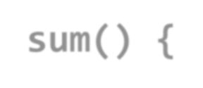

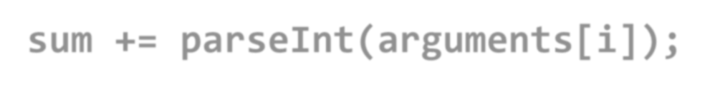
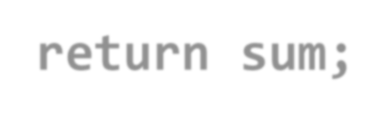

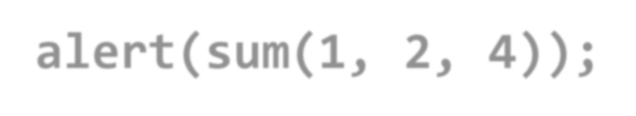
Function Arguments & Return Value
Functions are not required to return a value
When declaring function it is not obligatory to specify all of its arguments
The function has access to all the arguments passed via arguments array
42

Slide 43
JavaScript Debugger
All modern browsers have a built-in JavaScript debugger.
We can use console.log() to display JavaScript values in the debugger window:
<!DOCTYPE html>
<html>
<body>
<p>Activate debugging in your browser (Chrome, IE, Firefox) with F12, and select "Console" in the debugger menu.</p>
<script>
a = 5;
b = 6;
c = a + b;
console.log(c);
</script>
</body>
</html>

Slide 44
The debugger keyword
The debugger keyword stops the execution of JavaScript, and calls (if available) the debugging function.
This has the same function as setting a breakpoint in the debugger.
If no debugging is available, the debugger statement has no effect.
With the debugger turned on, following code will stop executing before it executes the third line:
<!DOCTYPE html>
<html>
<body>
<p id="demo" > </p>
<p>With the debugger turned on, the code below should stop executing before it executes the third line.</p>
<script>
let x = 15 * 5;
debugger;
document.getElementById("demo").innerHTML = x;
</script>
</body>
</html>

Slide 45
Outline
JavaScript: Overview of JavaScript, using JS in an HTML (Embedded, External), Data types, Control Structures, Arrays, Functions and Scopes, Objects in JS, JavaScript debugger
DOM: DOM levels, DOM Objects and their properties and methods, Manipulating DOM,
JQuery: Introduction to JQuery, Loading JQuery, Selecting elements, changing styles, creating elements, appending elements, removing elements, handling events.

Slide 46
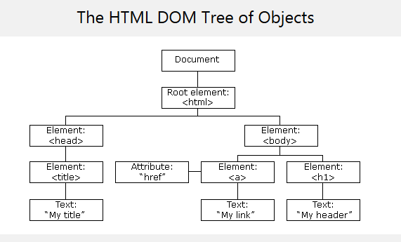
DOM- Document Object Model
When a web page is loaded, the browser creates a Document Object Model of the page.
The HTML DOM model is constructed as a tree of Objects (HTML tags):
Nested tags are called children of enclosing tags

Slide 47
What is the DOM?
The DOM is a W3C (World Wide Web Consortium) standard for accessing documents:
"The W3C Document Object Model (DOM) is a platform and language-neutral interface that allows programs and scripts to dynamically access and update the content, structure and style of a document."
The W3C DOM standard is separated into 3 different parts:
Core DOM - standard model for all document types
XML DOM - standard model for XML documents
HTML DOM - standard model for HTML documents

Slide 48
DOM Objects and their properties and methods
In the DOM, all HTML elements are defined as objects.
The programming interface is the properties and methods associated with each DOM object.
HTML DOM properties are values (attributes of HTML Elements) that we can set or change.
HTML DOM methods are actions (like add or deleting an HTML element) we can perform on HTML Elements.

Slide 49
Benefits of DOM to JavaScript
With the object model, JavaScript gets all the power it needs to create dynamic HTML:
JavaScript can change all the HTML elements in the page
JavaScript can change all the HTML elements’ attributes in the page
JavaScript can change all the CSS styles in the page
JavaScript can remove existing HTML elements and attributes
JavaScript can add new HTML elements and attributes
JavaScript can react to all existing HTML events in the page
JavaScript can create new HTML events in the page

Slide 50


DOM Example 1
The following example changes the content (the innerHTML) of the <p> element with id="demo":
Output
Example
<html>
<body>
<h1>My First Page</h1>
<p id="demo"></p>
<script>
document.getElementById("demo").innerHTML = "Hello World!";
</script>
</body>
</html>
In the example above, getElementById () is a method, while innerHTML is a property.

Slide 51
getElementById & innerHTML
The getElementById Method:
The most common way to access an HTML element is to use the id attribute of the element.
In the example above the getElementById method used id="demo" to find the target element.
The innerHTML Property:
The easiest way for getting or replacing the content of an element is by using the innerHTML property.

Slide 52
DOM Levels
DOM Level 1
DOM Level 2
DOM Level 3

Slide 53
DOM Level 1
The DOM Level 1 specification is separated into two parts:
Core & HTML
DOM Level 1 provides low-level (Core) and higher-level (HTML) interfaces that are used to provide a more convenient view of an HTML document.
Interfaces introduced in DOM1 include: the Document, Node, Attr, Element, and Text interfaces.

Slide 54
DOM Level 2
The DOM Level 2 specification contains six different specifications:
The DOM2 Core,
Views,
Events,
Style,
Traversal and Range, and
The DOM2 HTML.

Slide 55
DOM Level 2
Specification | Description
DOM Level 2 Core | helps the programs and scripts to access and update the content and structure of document dynamically
DOM Level 2 Views | allows programs and scripts to dynamically access and update the content of an HTML or XML document
DOM Level 2 Events | provides a generic event system to programs and scripts
DOM Level 2 Style | allows programs and scripts to dynamically access and update the content of style sheets
DOM Level 2 Traversal and Range | allows programs and scripts to dynamically traverse and identify a range of content in a document
DOM Level 2 HTML | allows programs and scripts to dynamically access and update the content and structure of HTML 4.01 and XHTML 1.0 documents

Slide 56
DOM Level 3
The DOM Level 3 specification contains five different specifications:
The DOM3 Core,
Load and Save,
Validation,
Events, and
XPath.

Slide 57
DOM Level 3
Specification | Description
DOM Level 3 Core | allows programs and scripts to dynamically access and update the content, structure and document style
DOM Level 3 Load and Save | allows programs and scripts to dynamically load the content of an XML document into a DOM document
DOM Level 3 Validation | allows programs and scripts to dynamically update the content and structure of documents and ensures that the document remains valid

Slide 58
Finding HTML Elements
Method | Description
document.getElementById(id) | Find an element by element id
document.getElementsByTagName(name) | Find elements by tag name
document.getElementsByClassName(name) | Find elements by class name

Slide 59
Changing HTML Elements
Method | Description
element.innerHTML = new_html_content | Change the inner HTML of an element
element.attribute = new_value | Change the attribute value of an HTML element
element.setAttribute(attribute, value) | Change the attribute value of an HTML element
element.style.property = new_style | Change the style of an HTML element

Slide 60
Adding and Deleting Elements
Method | Description
document.createElement(element) | Create an HTML element
document.removeChild(element) | Remove an HTML element
document.appendChild(element) | Add an HTML element
document.replaceChild(element) | Replace an HTML element
document.write(text) | Write into the HTML output stream

Slide 61
Adding Event Handlers
Method | Description
document.getElementById(id).onclick = function(){code} | Adding event handler & its code to an onclick event

Slide 62
Finding HTML Objects
Property | Description | DOM
document.baseURI | Returns the absolute base URI of the document | 3
document.body | Returns the <body> element | 1
document.cookie | Returns the document's cookie | 1
document.doctype | Returns the document's doctype | 3
document.forms | Returns all <form> elements | 1
document.head | Returns the <head> element | 3
document.images | Returns all <img> elements | 1

Slide 63
Changing HTML Content
Example
<html> <body>
<h2>JavaScript can Change HTML</h2>
<p id="p1">Hello World!</p>
<script>
document.getElementById("p1").innerHTML = "New text!";
</script>
<p>The paragraph above was changed by a script.</p>
</body> </html>
Output
JavaScript can Change HTML
New text!
The paragraph above was changed by a script.

Slide 64
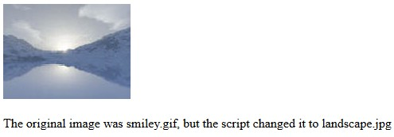
Changing the Value of an Attribute
Example
<html><body>
<img id="image" src="smiley.gif" width="160" height="120">
<script>
document.getElementById("image").src = "landscape.jpg";
</script>
<p>The original image was smiley.gif, but the script changed it to
landscape.jpg
</p>
</body></html>
Output

Slide 65
Sample DOM manipulations using JavaScript
Access and change text content of an HTML element
Access and change the text color & background color of text content of an HTML element:
document.getElementsByTagName("LI")[1].style.color="red";
Access element by class:
<div class="example"> First div element with class as "example".</div>
var x = document.getElementsByClassName("example");
x[0].innerHTML = "Hello World!";+
Access the URI of HTML document:
var x = document.;
document.getElementById("dedocumentURImo").innerHTML = x;

Slide 66
Sample DOM manipulations using JavaScript
Access the URI of HTML document:
<!DOCTYPE html>
<html>
<body>
<p>Click the button to display the domain name of the server that loaded this document.</p>
<button onclick="myFunction()">Try it</button>
<p id="demo"></p>
<script>
function myFunction() {
document.getElementById("demo").innerHTML = document.documentURI;
}
</script>
</body>
</html>

Slide 67
Sample DOM manipulations using JavaScript
Print number of Input Elements on webpage:
<!DOCTYPE html>
<html>
<head>
<script>
function getElements() {
var x = document.getElementsByTagName("input");
document.getElementById("demo").innerHTML = x.length;
}
</script>
</head>
<body>
<input type="text" size="20"><br>
<input type="text" size="20"><br>
<input type="text" size="20"><br>
<p>
<input type="button" onclick="getElements()" value="How many input elements?">
</p>
<p id="demo"></p>
</body>
</html>

Slide 68
continued..
Create an element through javascript:
var btn = document.createElement("BUTTON");
btn.innerHTML = "CLICK ME";
document.body.appendChild(btn);
Create an attribute for any element:
var li= document.getElementsByTagName("LI")[0];
var attri = document.createAttribute("class");
attri.value = "democlass";
li.setAttributeNode(attri);
<style>
.democlass {
color: red;
}
</style>

Slide 69
continued…
Create the onmouseover attribute to simulate hover effect:
<p id="demo">Hover over this paragraph to see the change...</p>
<script>
(function() {
var p= document.getElementById("demo");
var attri= document.createAttribute("onmouseover");
attri.value="myFunction()";
p.setAttributeNode(attri);
})();
function myFunction()
{
document.getElementById("demo").innerHTML="See..!! I changed....";
}
</script>

Slide 70
continued…
Give focus to an element:
<input type="text" id= "textfield1" >
document.getElementById(“textfield1").focus();
Assignment 2:
Use document.images and document.scripts and print the sources of the images and external scripts used in an HTML document. (dynamically create an unordered list for these sources)

Slide 71
Outline
JavaScript: Overview of JavaScript, using JS in an HTML (Embedded, External), Data types, Control Structures, Arrays, Functions and Scopes, Objects in JS,
DOM: DOM levels, DOM Objects and their properties and methods, modifying element style, the document tree, DOM event handling
JQuery: Introduction to JQuery, Loading JQuery, Selecting elements, changing styles, creating elements, appending elements, removing elements, handling events, AngularJS overview.

Slide 72
jQuery - Introduction
jQuery is a JavaScript Library.
jQuery greatly simplifies JavaScript programming.
jQuery also simplifies a lot of the complicated things from JavaScript, like AJAX calls and DOM manipulation.
The jQuery library contains the following features:
HTML/DOM manipulation
CSS manipulation
HTML event methods
Effects and animations
AJAX

Slide 73
Adding jQuery to Your Web Pages
Following are the ways to start using jQuery on your Website:
Download the jQuery library from jQuery.com
Include jQuery from a CDN, like Google

Slide 74
Downloading jQuery
There are two versions of jQuery available for downloading:
Production version - this is for live website because it has been minified and compressed
Development version - this is for testing and development
Both versions can be downloaded from jQuery.com.
The jQuery library is a single JavaScript file and we reference it within the HTML <script> tag
(note that the <script> tag should be inside the <head> section):
<head>
<script src="jquery-3.2.1.min.js"></script>
</head>
Tip: Place the downloaded file in the same directory as the pages where you wish to use it.

Slide 75
jQuery CDN
If you don't want to download and host jQuery yourself, you can include it from a CDN (Content Delivery Network).
Both Google and Microsoft host jQuery.
To use jQuery from Google or Microsoft, use it in the following:
Google CDN:
<head>
<script src="https://ajax.googleapis.com/ajax/libs/jquery/3.2.1/jquery.min.js">
</script>
</head>

Slide 76
jQuery Syntax
With jQuery you select (find and query) the HTML elements and perform certain "actions" on them.
syntax :
$(selector).action()
$ sign is to define/access jQuery
(selector) is to "query" (or find) HTML elements
action() specifies any jQuery action to be performed on the selected element(s)
Examples:
$(this).hide() - hides the current element.
$("p").hide() - hides all <p> elements.
$(".test").hide() - hides all elements with class="test".
$("#test").hide() - hides the element with id="test".

Slide 77
jQuery Selectors- for selecting the target elements
jQuery selectors allow you to select and further manipulate HTML element(s).
jQuery selectors are used to "find" (or select) the target HTML elements based on their name, id, class type, attributes, values of attributes and much more.
It's based on the existing CSS selectors and in addition, it has some own custom selectors.
All selectors in jQuery start with the dollar sign and are included in parentheses: $().

Slide 78
The element Selector
This jQuery element selector selects elements based on the HTML element's name.
With element selector you can select all <p> elements on a page like this:
$("p")
Example:
When a user clicks on a button, all <p> elements will be
hidden:
$(document).ready(function(){
$("button").click(function(){
$("p").hide();
});
});

Slide 79
The #id Selector
The jQuery #id selector uses the id attribute of an HTML tag to find the specific HTML element.
An id is unique at least within a page, so you should use the #id selector when you want to find a single, unique HTML element.
To find an element with a specific id, write a hash character (#), followed by the id of the HTML element:
$("#test")
Example
When a user clicks on a button, the element with id="test" will be hidden:
$(document).ready(function(){
$("button").click(function(){
$("#test").hide();
});
});

Slide 80
jQuery css() Method-for changing Style
jQuery css() Method
The css() method sets or returns one or more style
properties for the selected HTML elements.
Return a CSS Property
To return the value of a specified CSS property, use the following syntax:
css("propertyname");
Set a CSS Property
To set a specified CSS property, use the following syntax:
css("propertyname","value");

Slide 81
Changing Style-
Example to Return a CSS Property
<html><head>
<script src="https://ajax.googleapis.com/ajax/libs/jquery/3.2.1/jquery.min.js"></sc ript>
<script>
$(document).ready(function(){
$("button").click(function(){
alert("Background color is- " + $("p").css("background-color"));
});
});
</script>
</head><body>
<p style="background-color:#ff0000">This is a paragraph.</p>
<button>Return background-color of p</button>
</body></html>

Slide 82
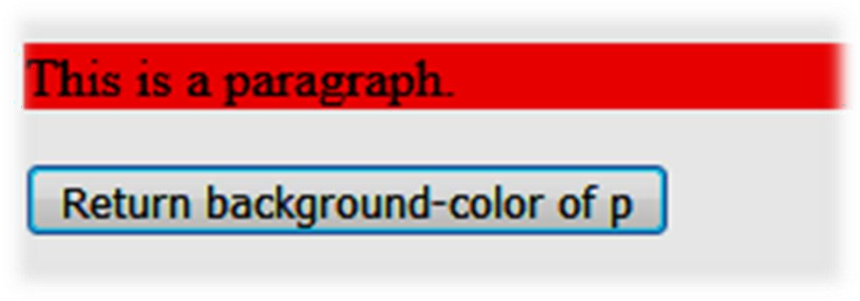

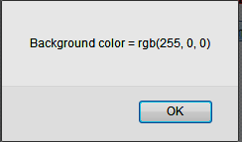
Changing Style-
Return a CSS Property Example o/p
Output of Previous Code

Slide 83





Changing Style-
Set a CSS Property Example
<html><head>
<script src="https://ajax.googleapis.com/ajax/libs/jquery/3.2.1/jquery.min.js"></script>
<script>
$(document).ready(function(){
$("button").click(function(){
$("p").css("background-color", "yellow");
});
});
</script>
</head>
<body>
<p style="background-color:#ff0000">This is a paragraph.</p>
<button>Set background-color of p</button>
</body></html>

Slide 84









Changing Style-
Set a CSS Property Example o/p
Output of Previous Code
After clicking on button

Slide 85
jQuery –Add Elements
We will look at four jQuery methods that are used to add new content:
append() - Inserts content at the end of the selected elements
prepend() - Inserts content at the beginning of the selected elements
after() - Inserts content after the selected elements
before() - Inserts content before the selected elements

Slide 86


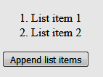

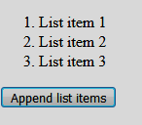
jQuery append( ) Method- Example
<html><head>
<script src="https://ajax.googleapis.com/ajax/libs/jquery/3.2.1/jquery.min.js"></script>
<script>
$(document).ready(function(){
$("#btn1").click(function(){
$("ol").append("<li> New List item </li>");
}); });
</script>
</head>
<body>
<ol>
<li>List item 1</li>
<li>List item 2</li>
</ol>
<button id="btn1"> Append list items </button>
</body></html>
After Clicking on button

Slide 87
jQuery - Remove Elements
Remove Elements/Content
To remove elements and content, there are mainly two jQuery methods:
remove() - Removes the selected element, its contents and also all the child elements
empty() – Removes the contents from the selected element & also the child elements (but selected element remains)

Slide 88

jQuery remove( ) Method- Example
<html > <head>
<script src="https://code.jquery.com/jquery-1.10.2.js">
</script>
</head>
<body>
<p> Hello <button>I will disappear..</button></p>
how are you?
<button id="b1">Remove </button>
<script>
$( "button" ).click(function() {
$( "p" ).remove();
});
</script>
</body></html>

Slide 89
jQuery Quiz link:
https://forms.office.com/r/JntqnShZHq

